Slide 1



AlphaGenome
Ryan Gallagher
Department of Pediatrics
08/29/2025

Slide 2
Intro
AlphaGenome¹: a deep learning model (AI) which takes megabase-scale DNA sequences as input and predicts regulatory variant effects and thousands of functional genomic signals
Potential For¹⁷:
Rare Disease Diagnostics:
The model’s variant effect predictions can offer functional evidence for annotation pipelines, helping to diagnose non-coding VUS
Molecular Biology:
It can be used for in silico experimentation to generate hypotheses and prioritize wet-lab experiments
Sequence Design:
Predictions for splicing, expression, and accessibility could accelerate applications like designing therapeutic antisense oligonucleotides and tissue-specific enhancers.
1

Slide 3
How it Works
A tool which intakes DNA sequence (up to 1MB) and outputs predictions for across diverse cell types for 11 output modalities at high resolution³.
2

Slide 4
Predicting Variant Effects
X Axis = Chromosome Position
Y Axis = Relative Expression
AlphaGenome scores a genetic variant by generating two separate predictions – one for the sequence with the reference (REF) allele and another for the sequence with the alternative (ALT) allele – and quantifies the difference between these two outputs⁴¹.
Top: Measured Expression¹⁰
Bottom: AlphaGenome Predicted Expression
3

Slide 5
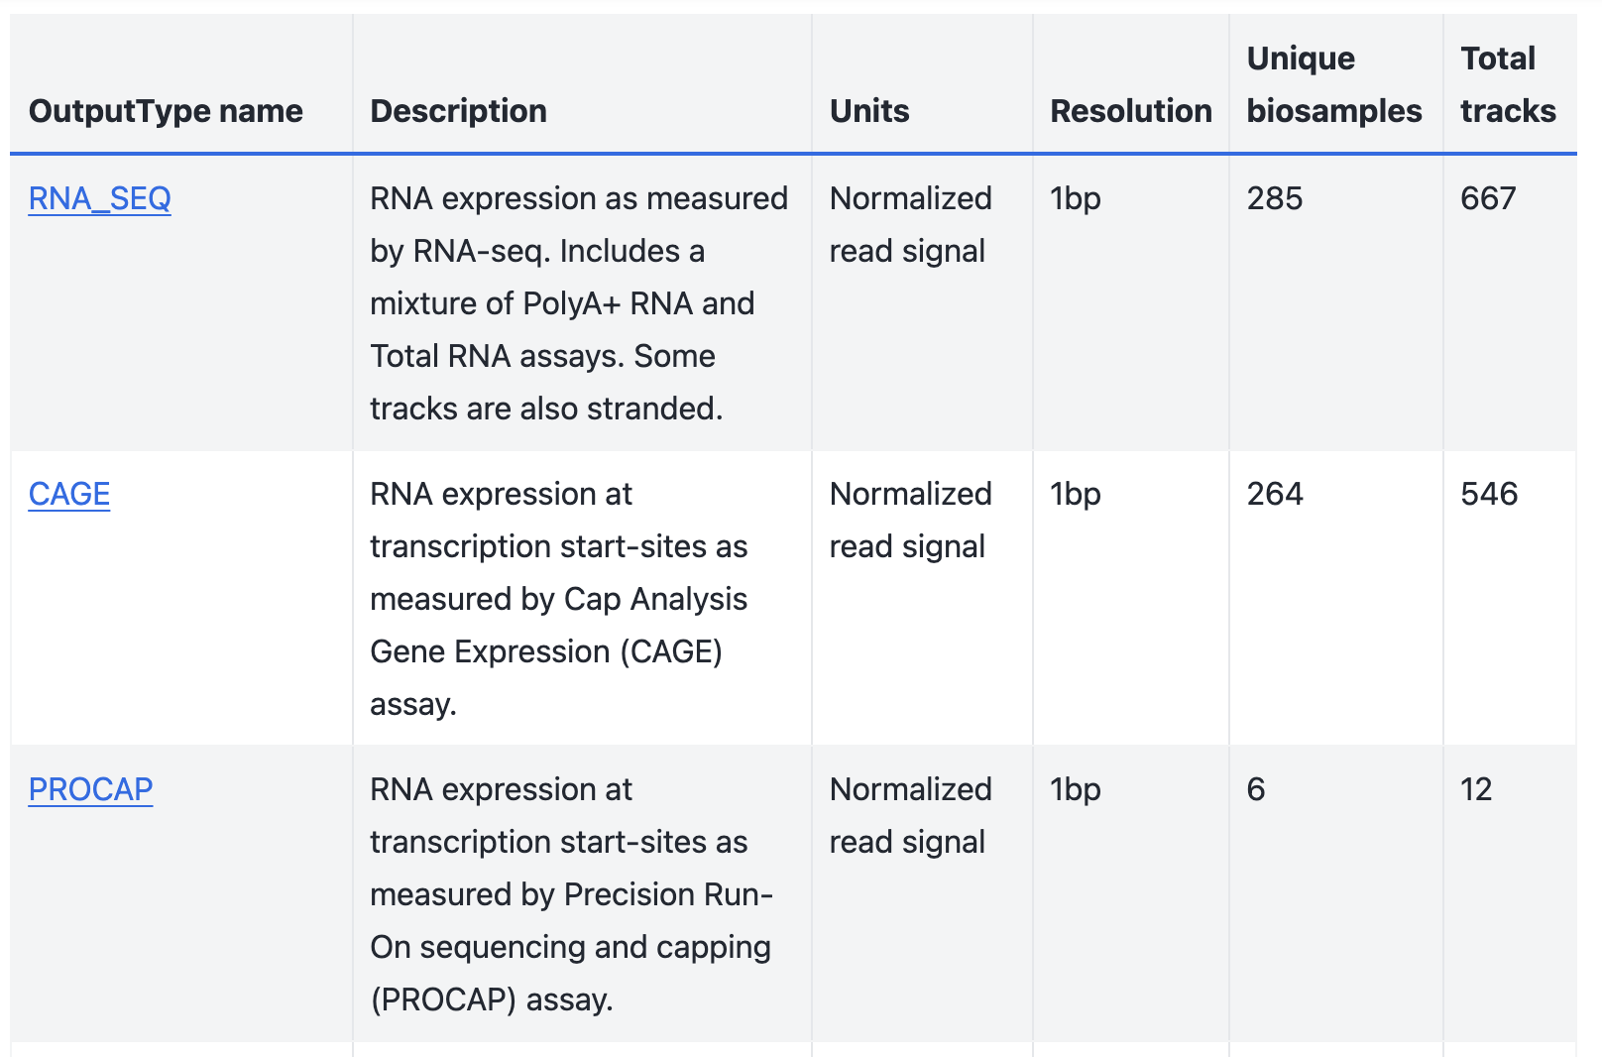
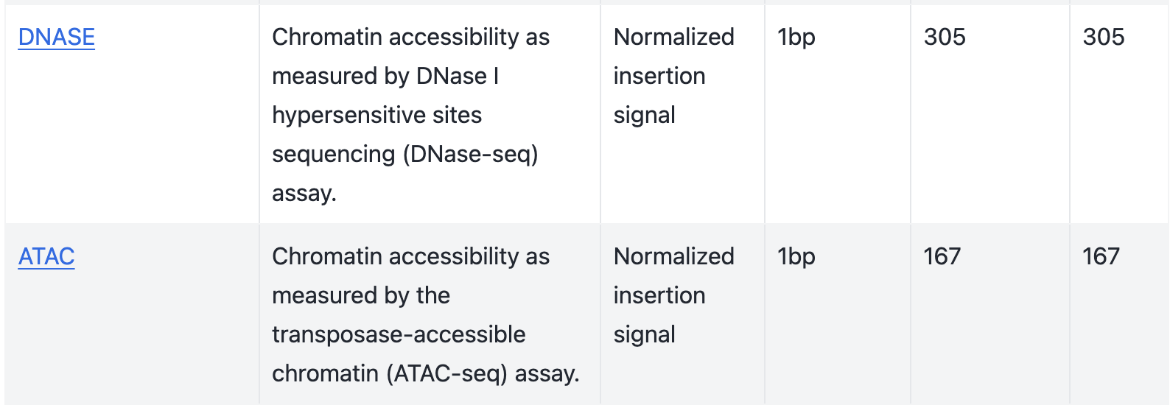
Types of Outputs
AlphaGenome can predict on 11 different types of biological data. In combination, these outputs allow for a comprehensive view of the regulatory landscape of a given sequence.
These tracks are not equally accessible for all cell types because AG’s predictions are entirely dependent on the experimental data that it was trained on.

Slide 6
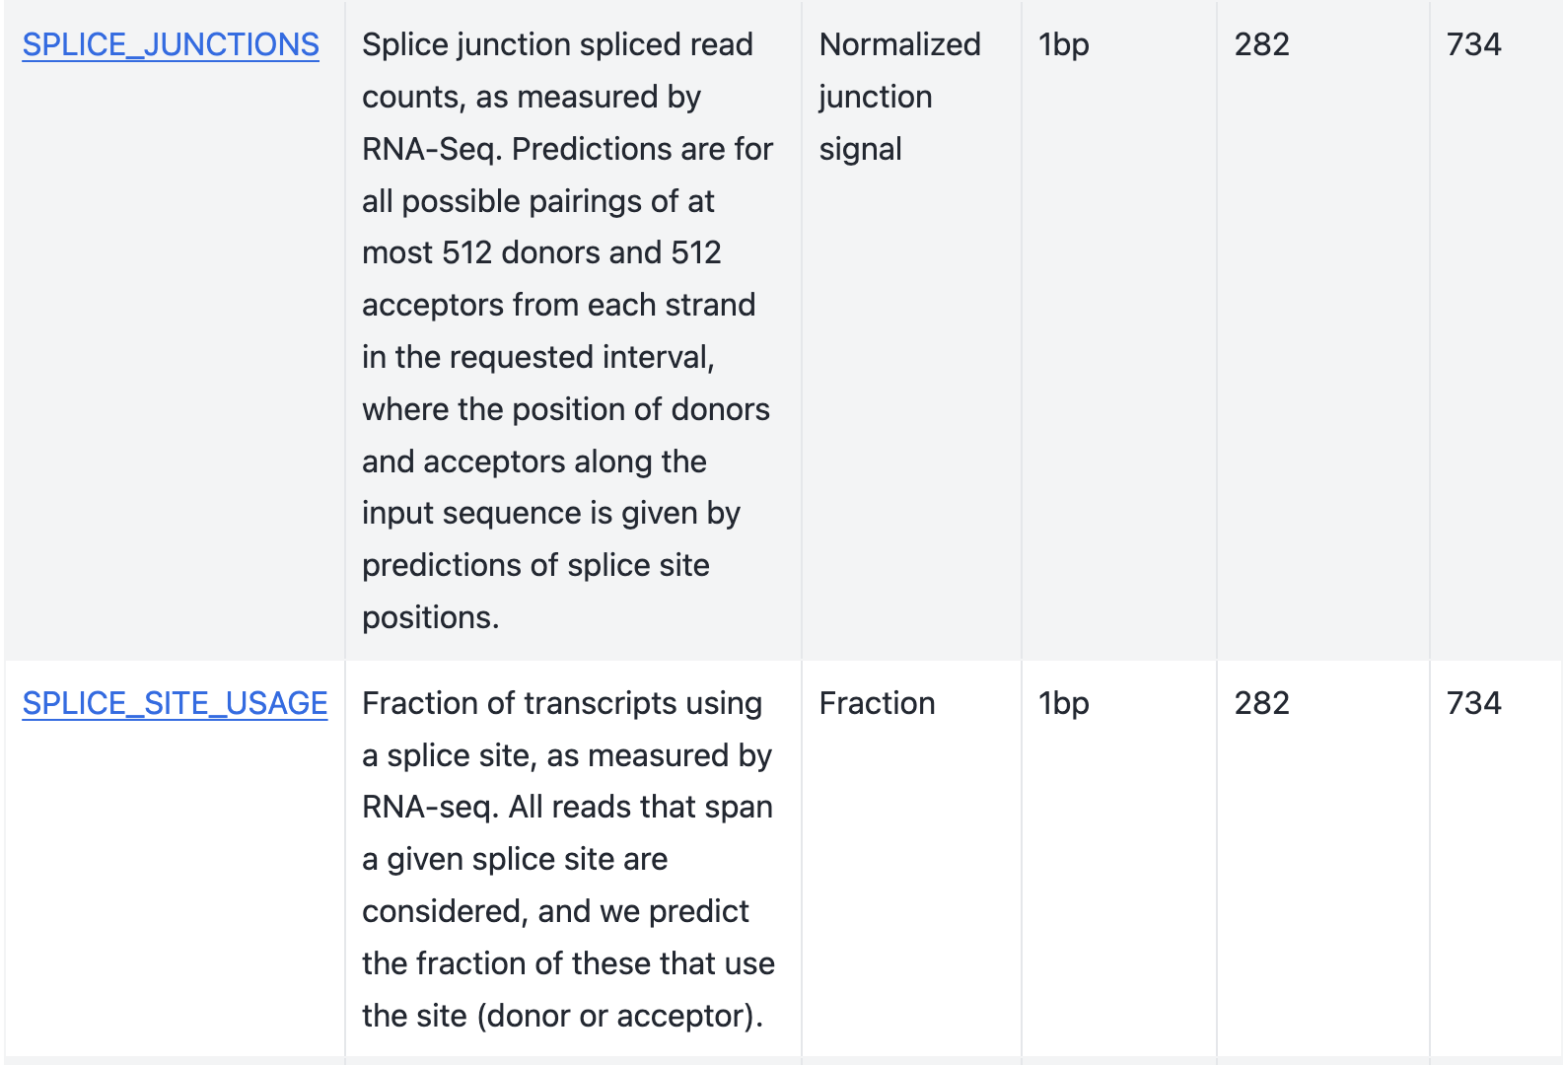
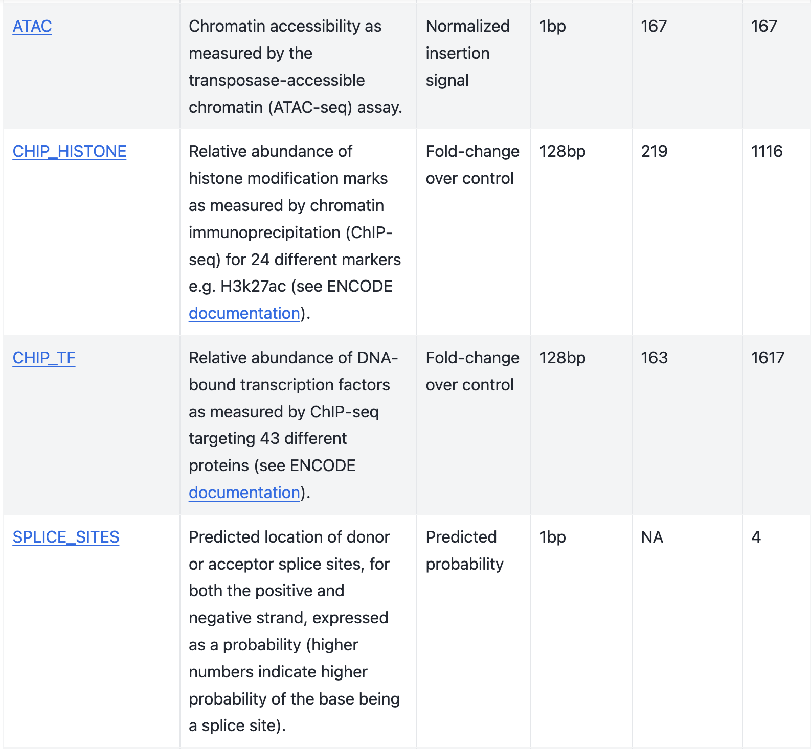
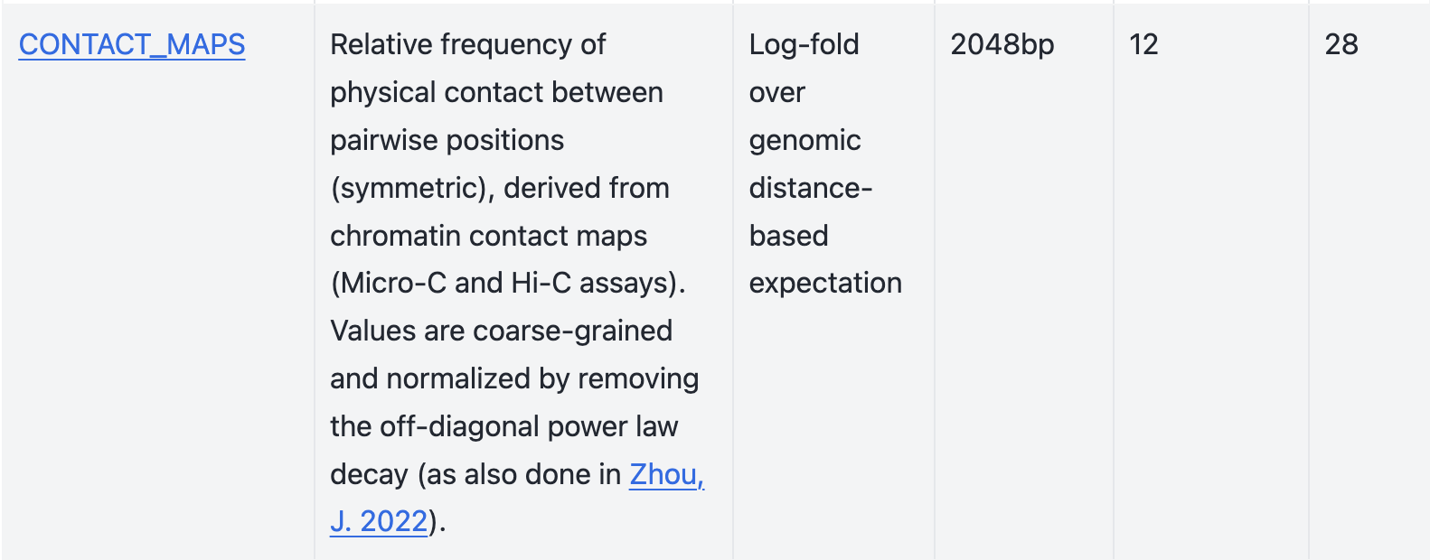
Types of Outputs cont

Slide 7
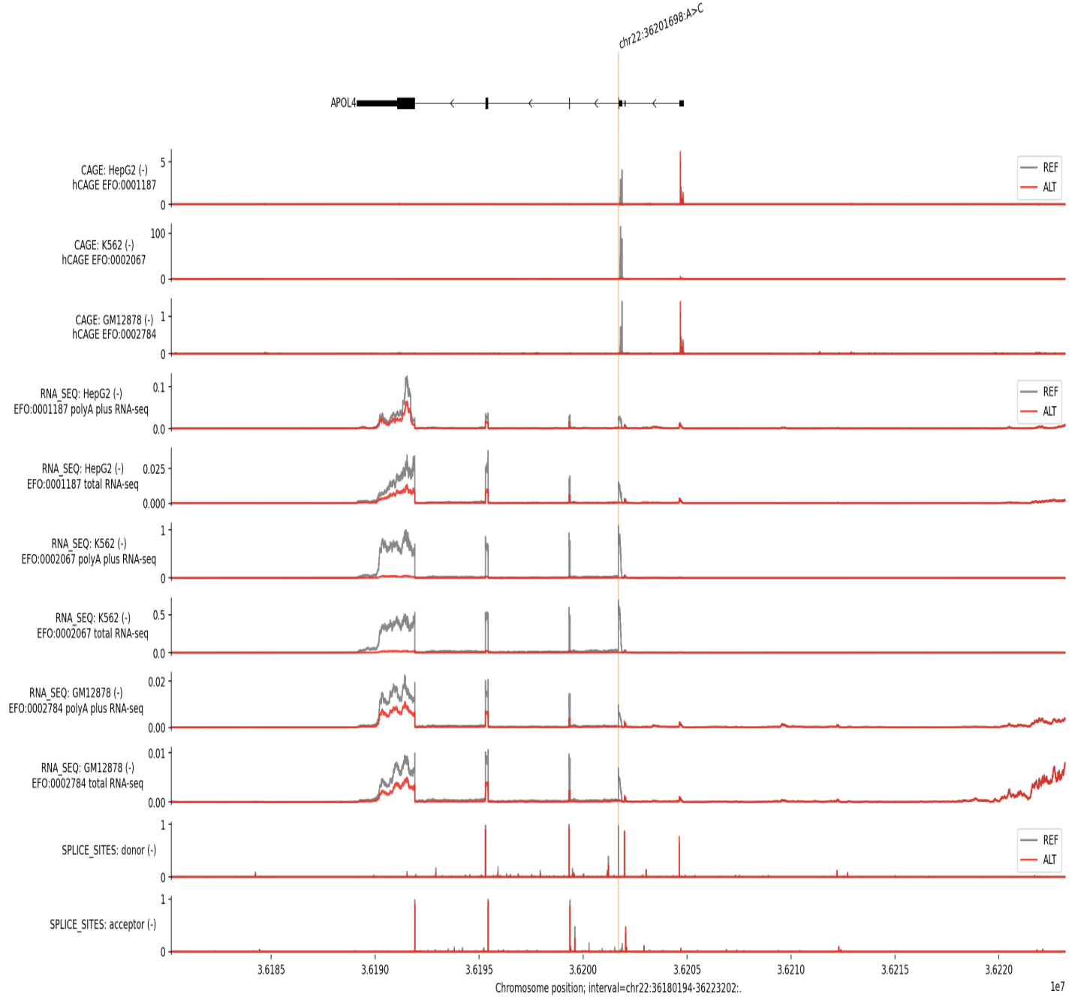
Example Output
From the documentation:
Again, using colon tissue over the APOL4 gene, we see outputs across CAGE, RNA-Seq (+,- strand), and Splice Sites.
We can compare the outputs for ALT (A>C mutation) vs. REF (no mutation).

Slide 8
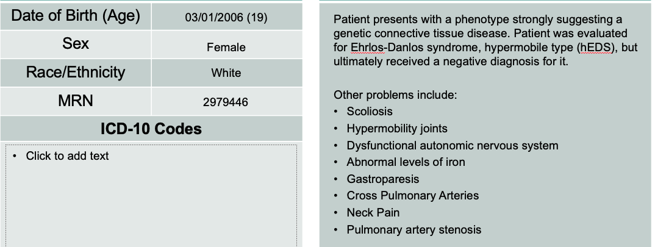
Worked Example – One of our SVs
Often in our SVI Analyses, we see intronic structural variants and are unable to easily interpret their function.
In this example, we’ll step back into one of our samples and choose a potentially relevant intronic SV to analyze via AlphaGenome
MCW SVI 0155 UDD

Slide 9
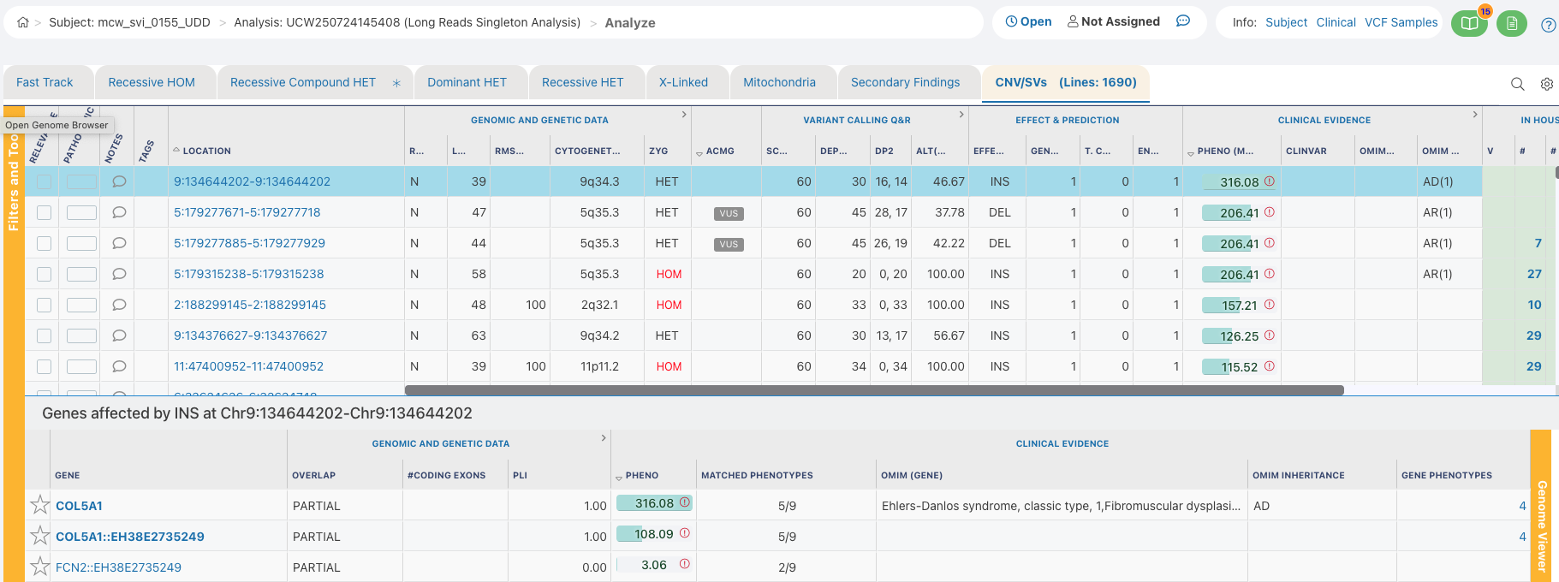
Worked Example – One of our SVs
Through Geneyx, we can easily find intronic structural variants (called by Sniffles2) with a phenotype score attached.
Here - we’ll select a 39bp Heterozygous deletion on Chr9 in the COL5A1 gene.

Slide 10
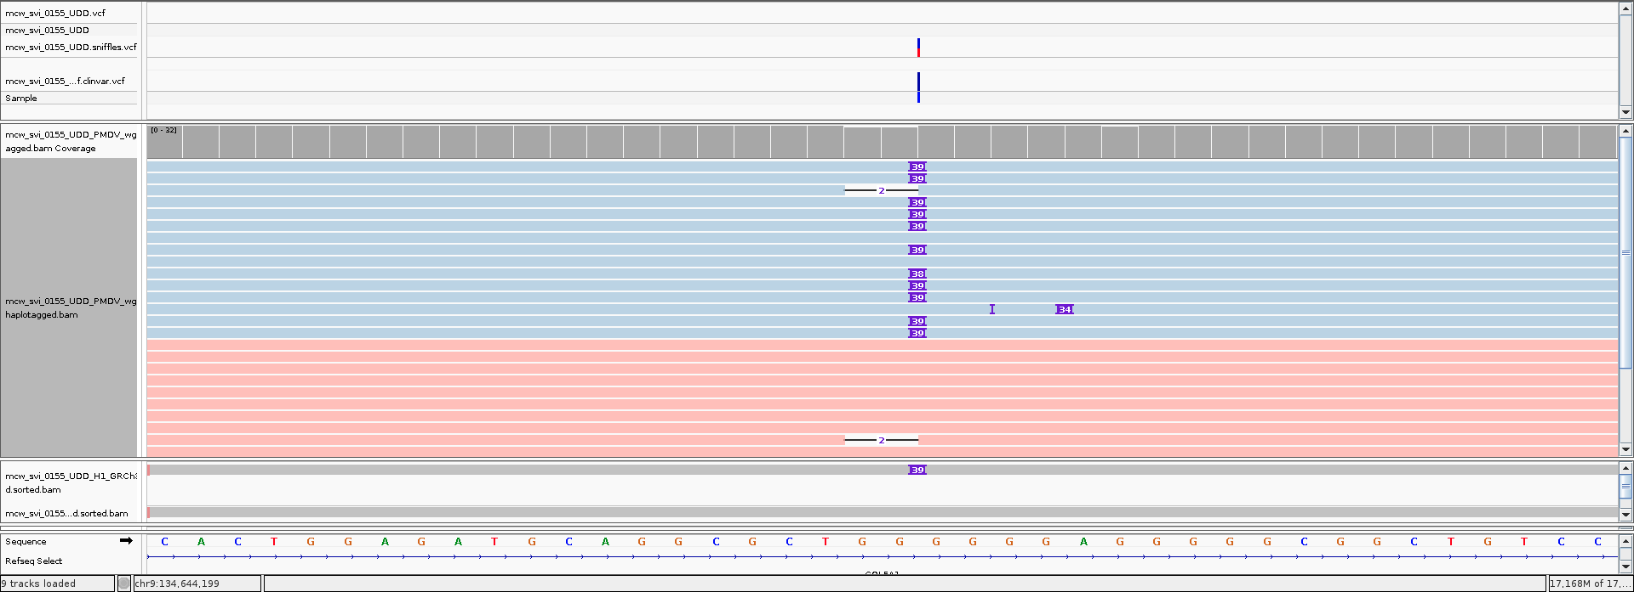
Worked Example – One of our SVs
Our call visualized

Slide 11
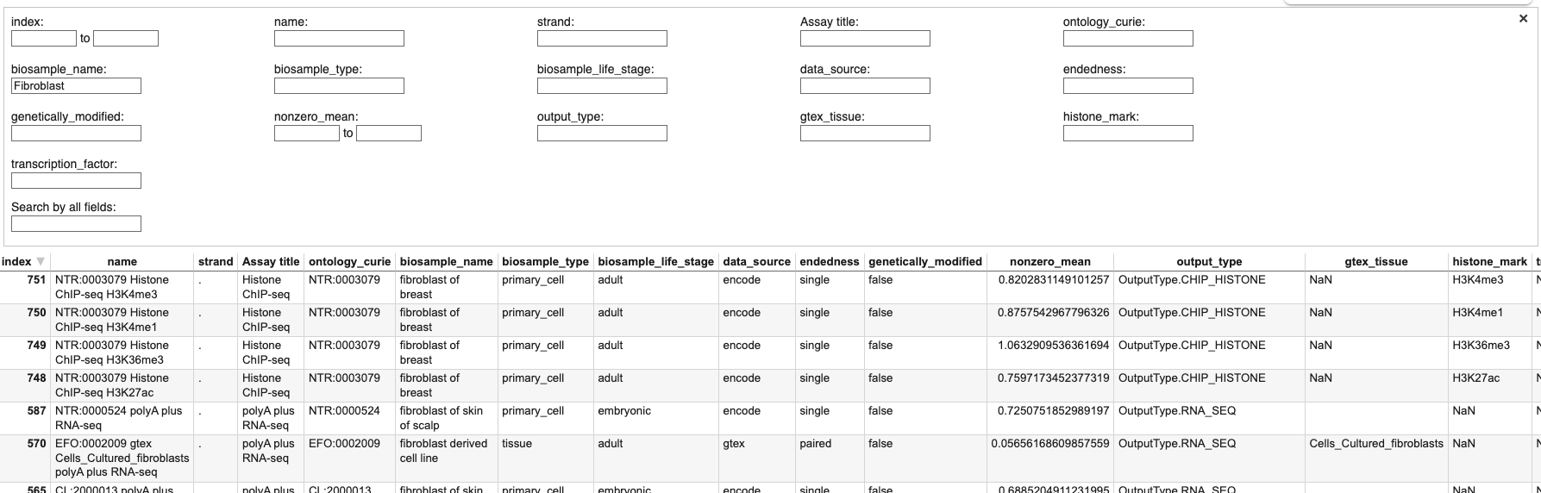
Worked Example – Selecting Cell Type
Given our patient’s phenotype and the disease types associated with COL5A1 (and Gemini’s help), I will use the cell types: Fibroblast of Dermis, Fibroblast of Lung, Fibroblast of the Aortic Adventitia, Foreskin Fibroblast
We can confirm the data availability through this table in AlphaGenome documentation.

Slide 12
Worked Example – Running AlphaGenome
AlphaGenome is accessible to users through an API. This API effectively is a key to access the model. This structure allows users to obtain information by submitting certain criteria (variant, cell type, output, etc…).
This information is organized and submitted via Python scripts on the command line. Retrieved data is organized and visualized client-side.

Slide 13
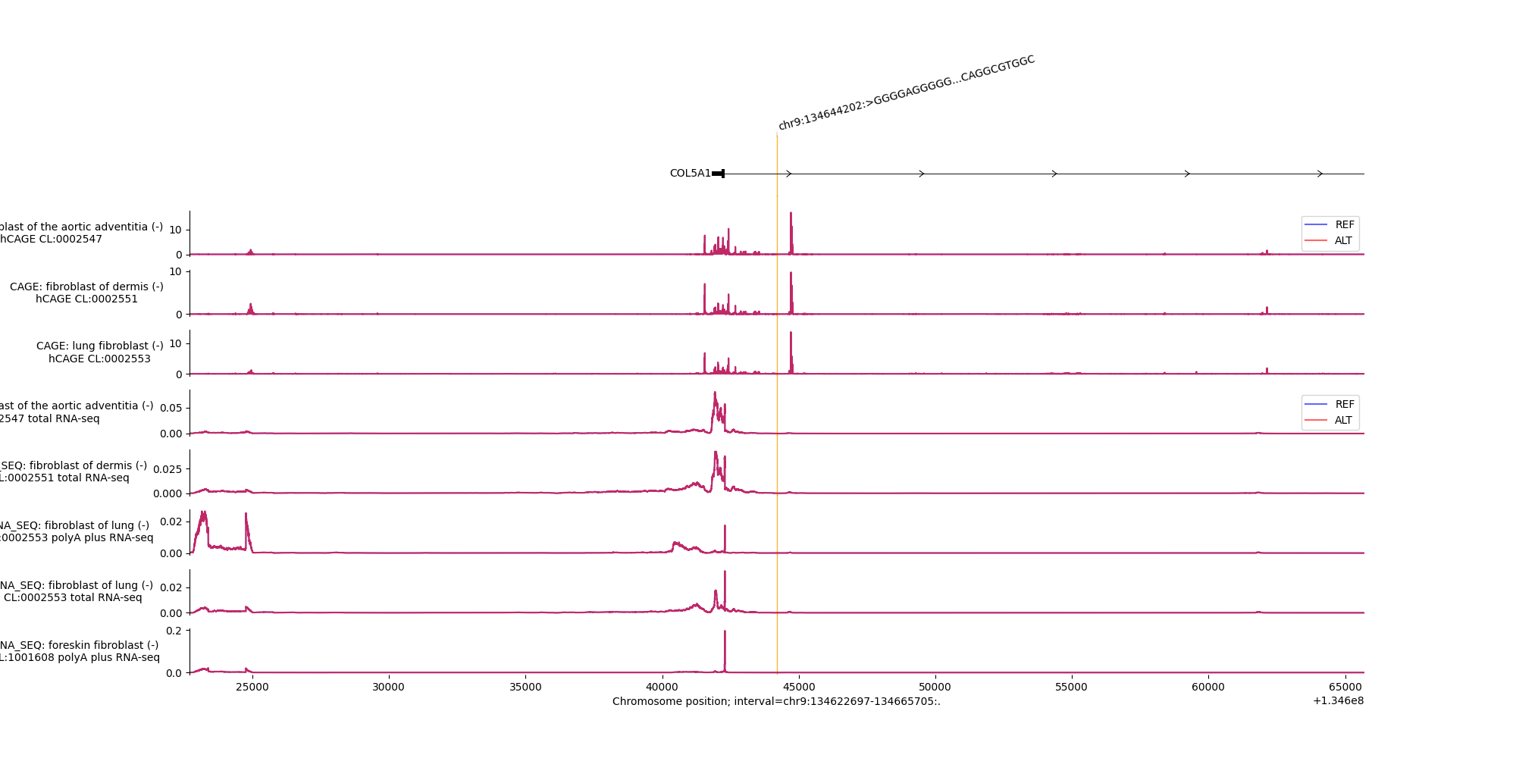
Worked Example – Output
Interpretation is made by looking at difference in signal in REF vs. ALT.

Slide 14
AlphaGenome Discussion
AlphaGenome is a powerful tool that allows users to look at the predictive difference between two genomic sequences – one with a mutation and one without.
The output of these predictions can be multifaceted based on the input sequence, predictive range, cell tissue specification, and output selection (depending on data availability). These can help answer a myriad of different questions about the genome.
Further applications could allow for a process to quantify the impact of all non-coding variants in future samples.

Slide 15
Resources
The preprint: AlphaGenome: advancing regulatory variant effect prediction with a unified DNA sequence model
Documentation: Exploring the genome with AlphaGenome
Author’s Demonstration: AlphaGenome101
Community Forums: Alphagenome-community

